Slide 1

Intro to ML
Notes:
Data Scientists working on clustering image data

Slide 2
What is ML?
A field of study concerned with making quantitative inferences and predictions from data
Uses statistical techniques and computational power to “learn” these inferences and predictions without being explicitly programmed
A little more formally: an algorithm is said to learn from data if its performance improves as the amount of data increases
Notes:
So to me and many researchers, there isn’t a difference. Others may disagree

Slide 3
Roots of machine learning
ML theory and methodology emerged from three main areas: artificial intelligence, signal processing, and statistics
Examples of contributions:
AI: Support vector machines, neural networks
SP: information theory, detection and estimation theory
Stats: regression, classification, a A probabilistic framework for handling uncertainty and randomness in the data
Artificial Intelligence
Signal Processing
Machine Learning
Statistics

Slide 4
Classical Statistics vs ML
What are the differences between classical statistics and ML?
There is an overlap of methods
Somewhat broadly, classical statistics focuses heavily on data modeling
ML typically focuses on the endgame/output (e.g., prediction)
A model is useless if it doesn’t give a good prediction
Many ML methods are based on statistical models
See Breiman (2001) for one viewpoint on the two fields: “Statistical Modeling: The Two Cultures”
Notes:
Ask, who has read it already?

Slide 5
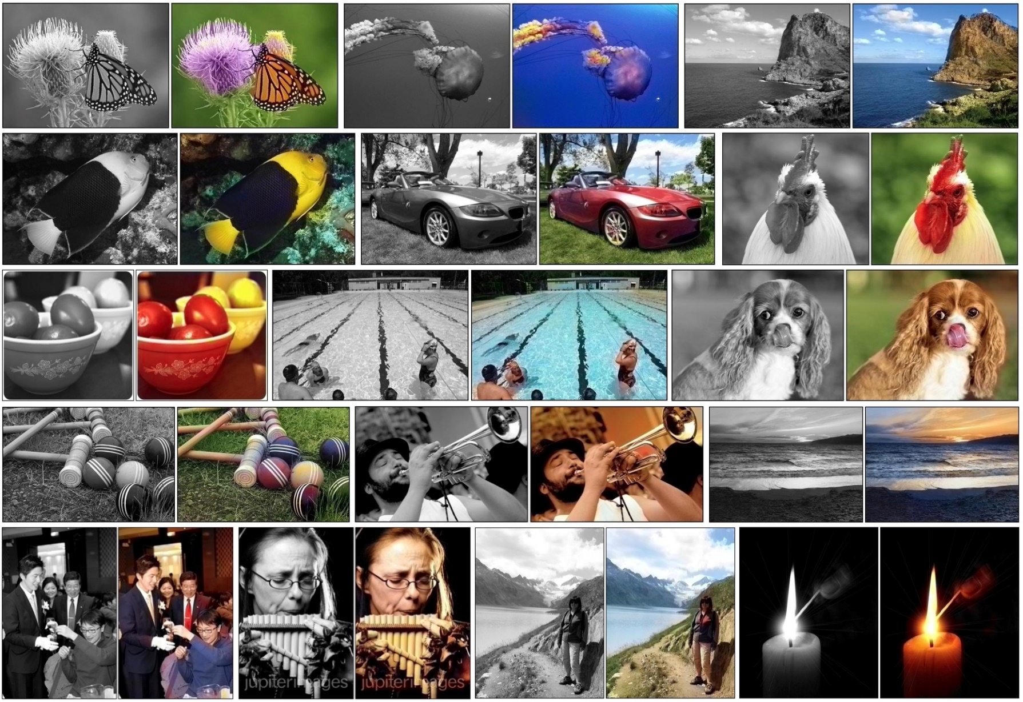
Success of Machine Learning/AI
Image colorization (Zhang et al., 2016)

Slide 6
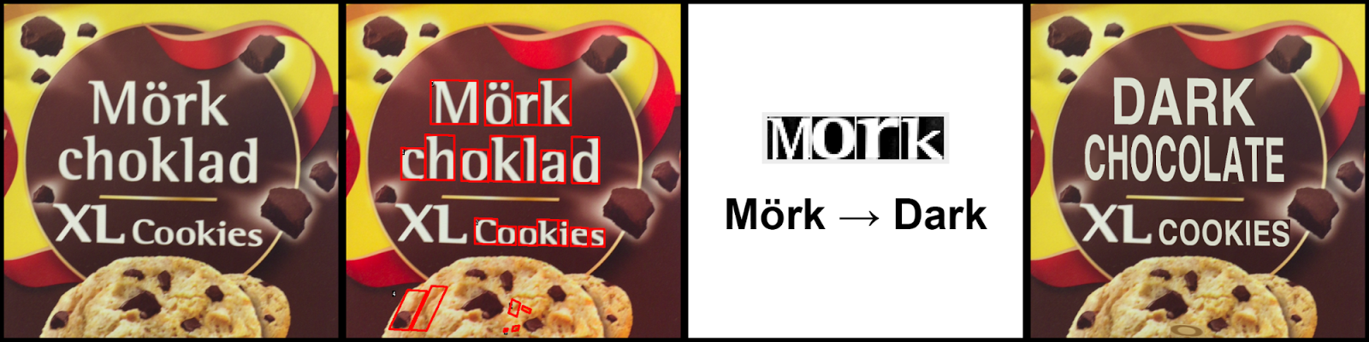
Success of Machine Learning/AI
Real-time visual translation on smartphones
Find the letters
Recognize the letters
Translate
Render the translation in the same style
Google blog, 2015
Notes:
The entire process is done using deep neural nets

Slide 7
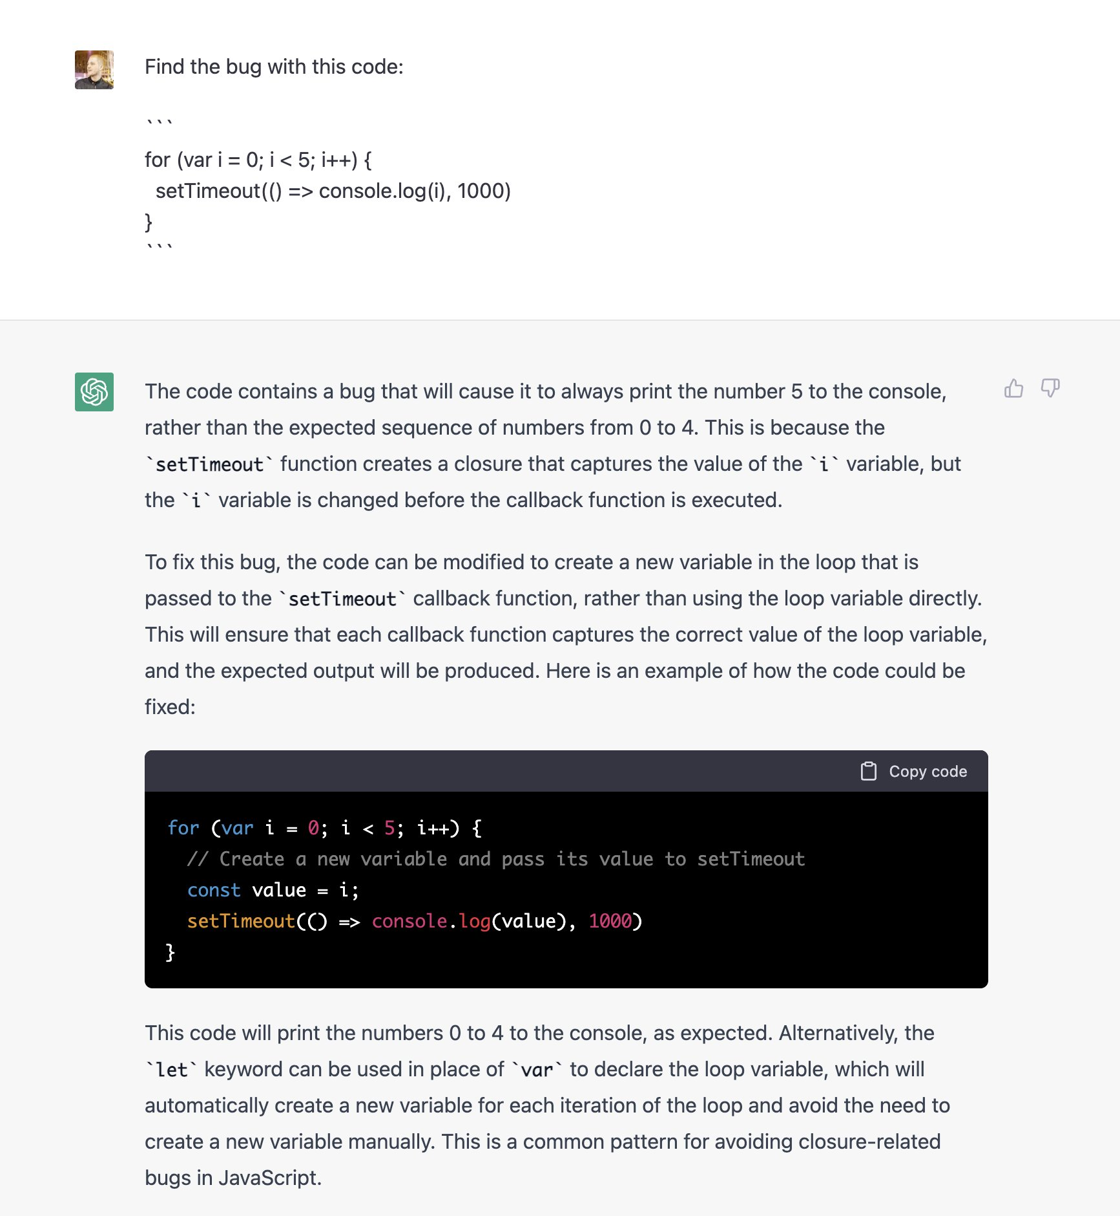
Success of Machine Learning
Automated programming with ChatGPT

Slide 8

Success of Machine Learning
AI generated art

Slide 9
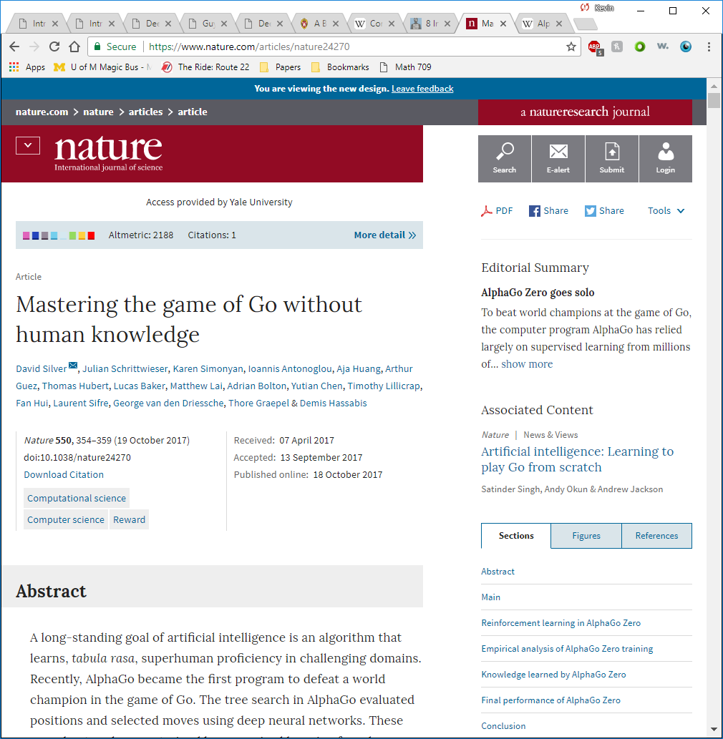
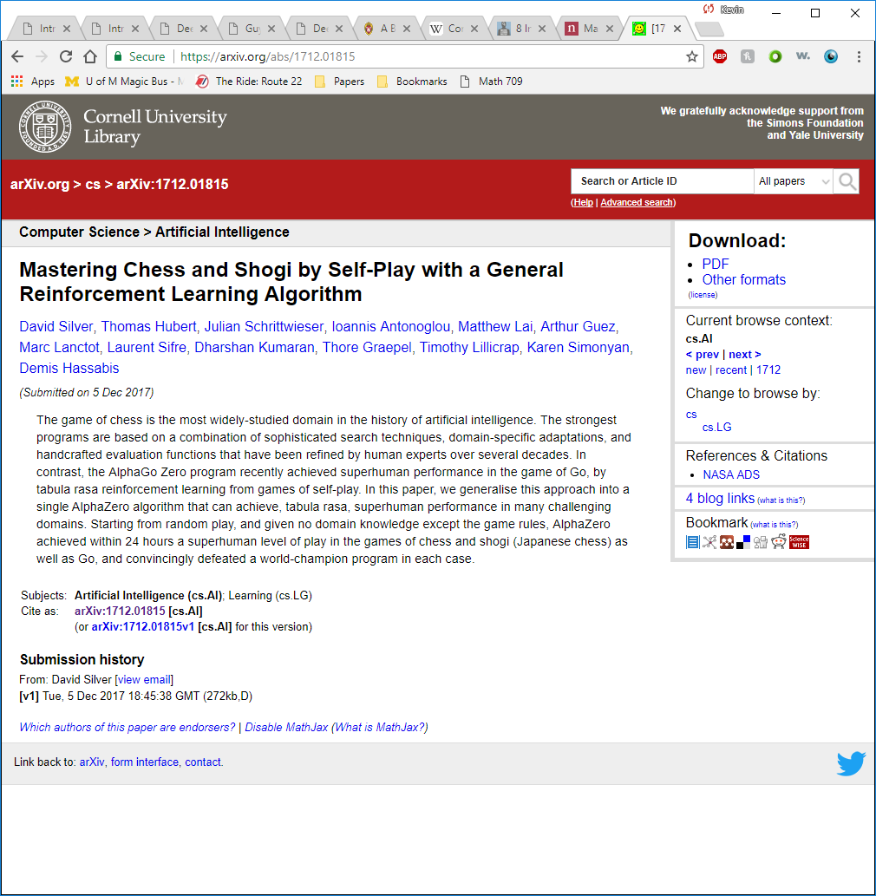
Success of Machine Learning
Automatic game playing
Alpha Go Zero
Alpha Zero

Slide 10
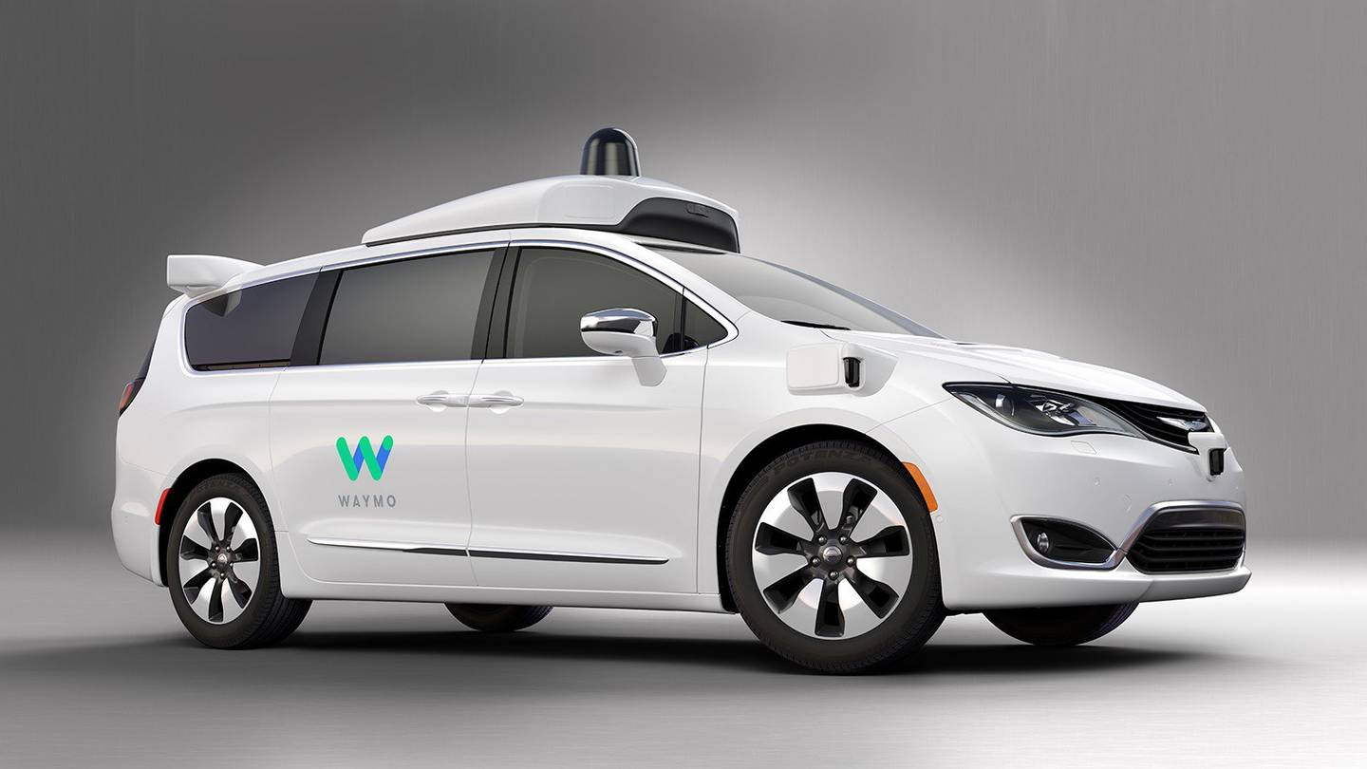
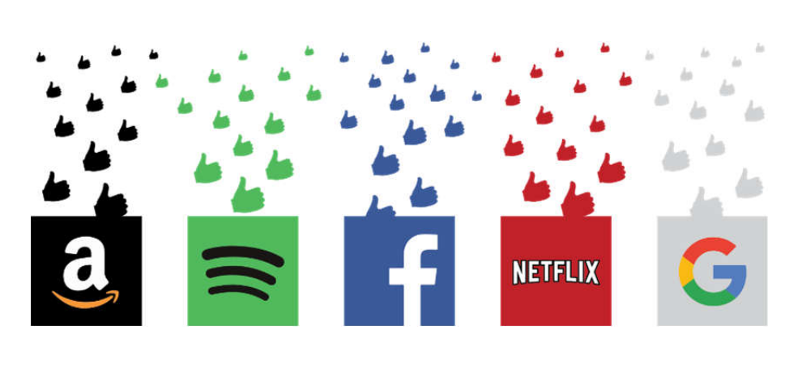
Other Machine Learning Applications
Chatbots (NLP)
Fraud detection
Route planning
Search engine refinement
Face recognition/detection
Credit risk assessment
Financial market prediction
Medical diagnosis
Personalized medicine
Electricity demand forecasting
Spam filtering
Collision avoidance systems
Speech synthesis/analysis (e.g. Siri, Alexa)
Recommender systems (e.g. Netflix, Spotify)

Slide 11
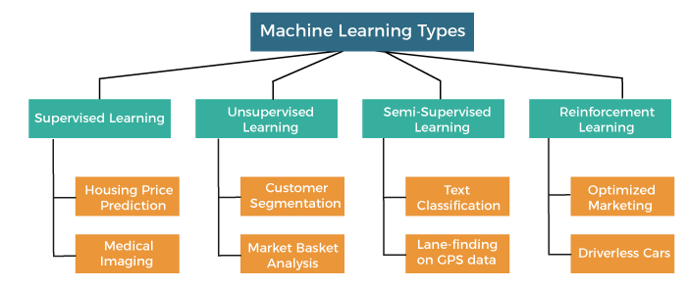
MACHINE LEARNING TYPES
Supervised
Classification
Regression
Unsupervised
Clustering
Dimensionality Reduction
Semi-supervised
Reinforcement

Slide 12
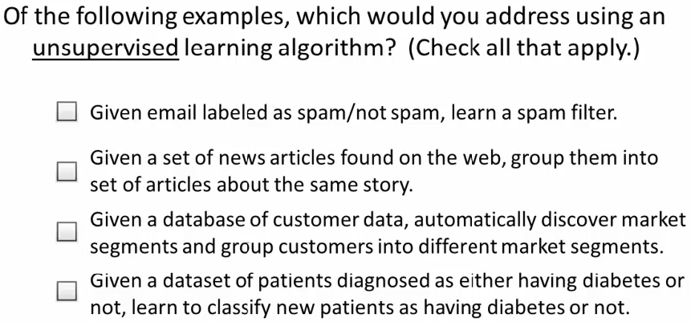
QUIZ
√
√

Slide 13
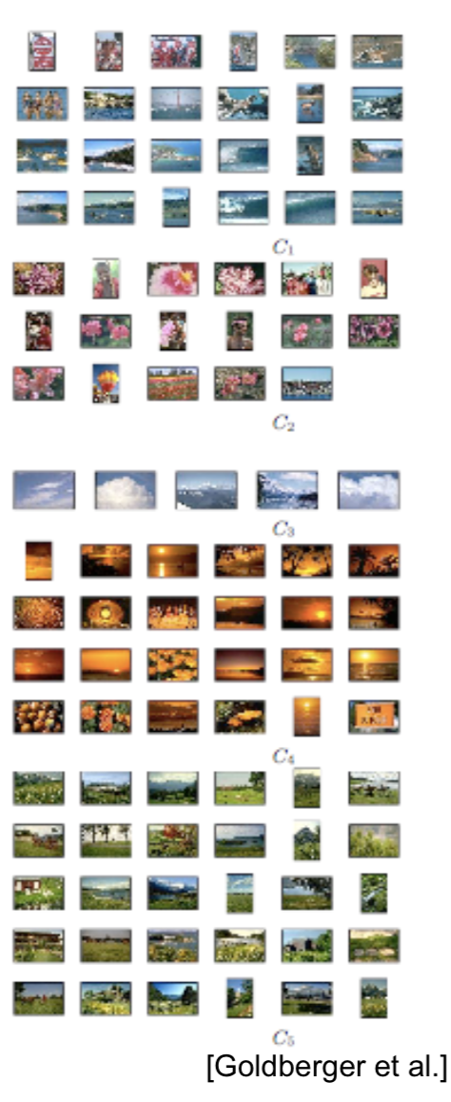
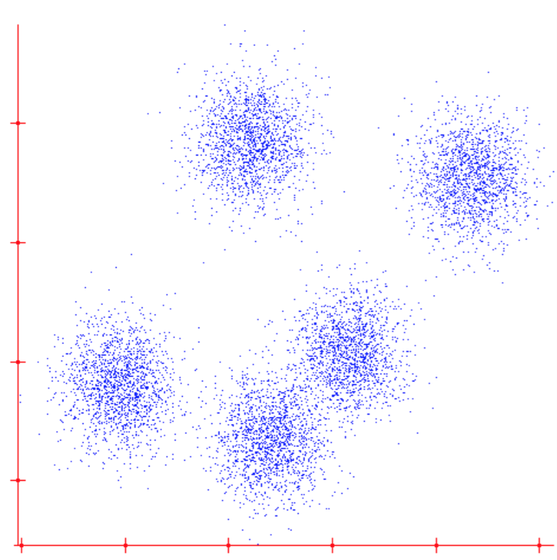
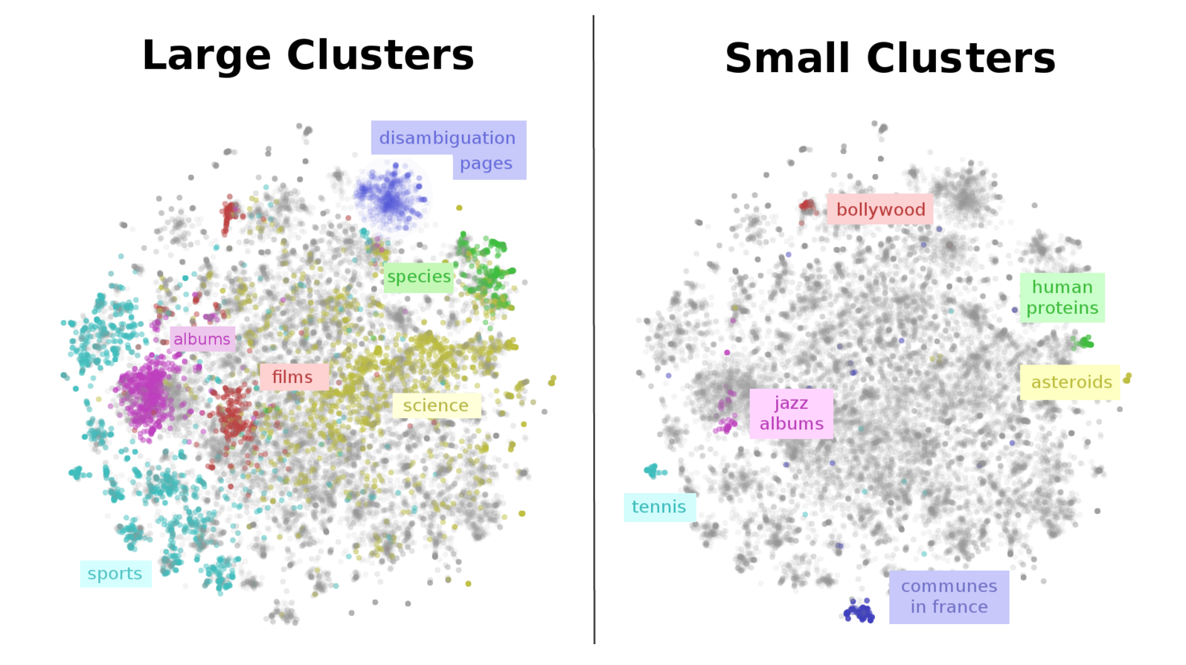
CLUSTERING DATA: GROUP SIMILAR THINGS
wikipedia articles

Slide 14
APPLICATIONS OF CLUSTER ANALYSIS
Customer Segmentation: In marketing, clustering helps to group customers based on behavior, preferences, or demographics.
This segmentation enables personalized marketing, targeted promotions, and better customer service.
Document Clustering: often used in natural language processing to organize large text corpora.
It groups similar documents, which is useful for topic modeling, or summarizing news articles.
Anomaly Detection: Can identify outliers in data.
Ex: in network security, clustering can detect unusual patterns of behavior that may indicate a cyberattack or fraud.

Slide 15
MORE APPLICATIONS OF CLUSTER ANALYSIS
Social Network Analysis: Clustering helps to find communities within social networks
by grouping users with similar connections, interests, or behaviors.
Genomics: clustering is used to classify genes with similar expression patterns,
helping in the discovery of gene functions and understanding of diseases.
Urban Planning and Geographic Analysis: Helps in analyzing geographic data
Ex: identifying areas with similar land use, demographic profiles, or crime rates, which aids in urban planning.

Slide 16
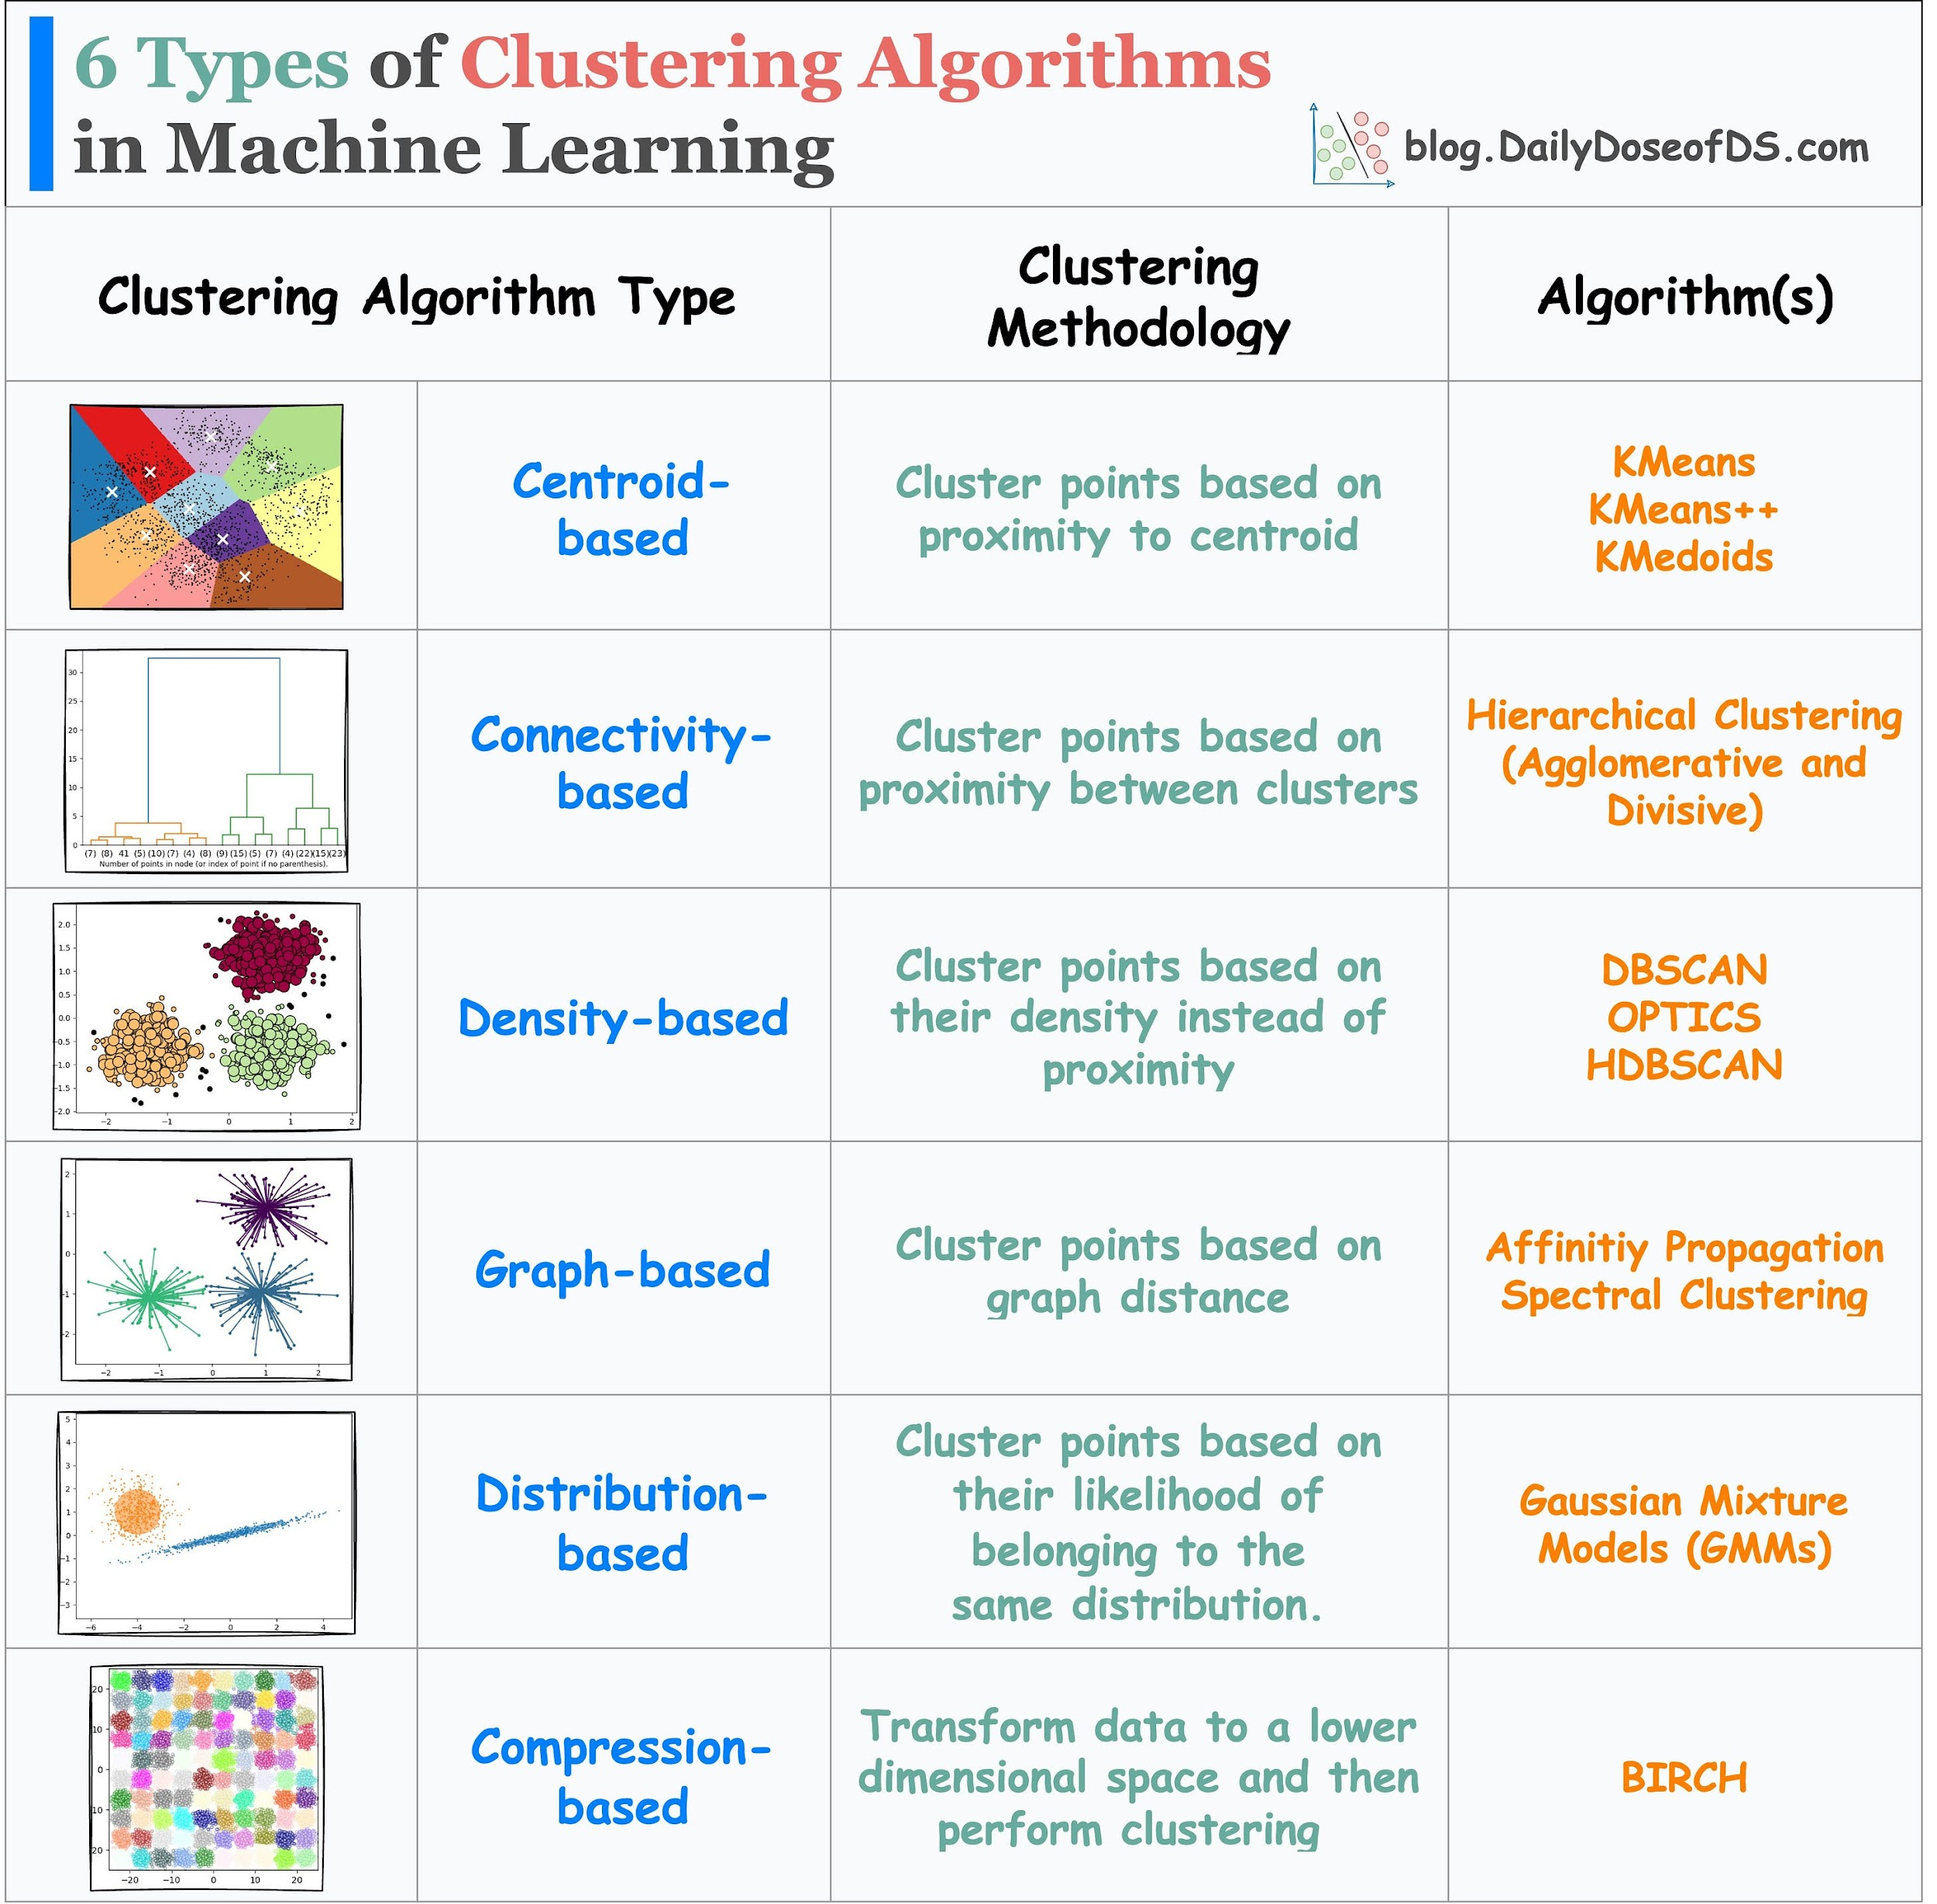
MAJOR TYPES OF CLUSTERING ALGORITHMS
Centroid-based: Cluster data points based on proximity to centroids.
Connectivity-based: Cluster points based on proximity between clusters.
Density-based: Cluster points based on their density. It is more robust to clusters with varying densities and shapes than centroid-based clustering.
Graph-based: Cluster points based on graph distance.
Distribution-based: Cluster points based on their likelihood of belonging to the same distribution. Gaussian Mixture Model in one example.
Compression-based: Transform data to a lower dimensional space and then perform clustering
Our focus:

Slide 17
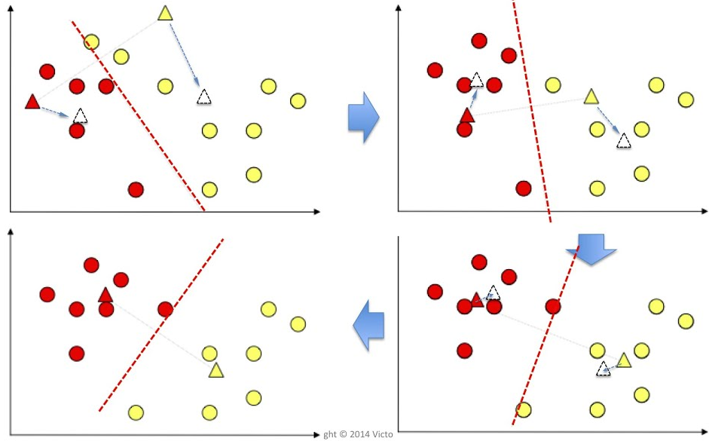
K-MEANS CLUSTERING
5
4
Standardize samples
Choose # clusters (K)
Choose # iterations
Randomly place initial centroids (Fig. A)
Calculate distance to centroid (Fig. A)
Assign samples with the nearest centroid color (Fig. A)
Move centroids to the mean of cluster (Fig. A)
Repeat 5-7 (Figs. B, C, D) until convergence
A
B
7
4
7
6
6
D
C
Notes:
Imagine you have a data set with two attributes. The data is plotted in Figure A. The objective is to group the data into clusters that are most alike. (In a real-world problem, there would be many more attributes and samples)
Start preparing the data set by standardizing the values. This means scaling all attributes to have zero mean and a standard deviation of +/- 1. We need to do this so that no attribute biases the process.
Choose the number of iterations to run the K-means algorithm. Usually, this algorithm converges very fast. If you have a large data set, it could take longer. Typically, it takes between 50-100 iterations or less.
Choose the number of Clusters. In this example, we’ve chosen 2. The best number of clusters can be estimated using algorithms like the “Elbow” or “Silhouette” algorithms. Or this number may be driven by what is practical for implementation. For example, suppose you were trying to segment customers into various clusters and give them different marketing treatments. In that case, you might be limited in how many treatments you can manage (say 10-20 or less).
Initialize the cluster centroids (guesses for the cluster center). This can be done randomly (shown) or use a more intelligent estimate.
Calculate the distance (Euclidian or other) from the data sample to each cluster centroid.
Samples closest to the red centroid (triangle) become part of the red cluster. Samples closest to the yellow centroid (triangle) become part of the yellow cluster.
Calculate the center of each cluster and move the centroid (triangle) to this point.
Repeat the process of coloring data samples based on the distance to the nearest centroid. Recalculate centroid. Continue the process until the centroid no longer changes or maximum iterations are reached. Fig. B, C, D.

Slide 18
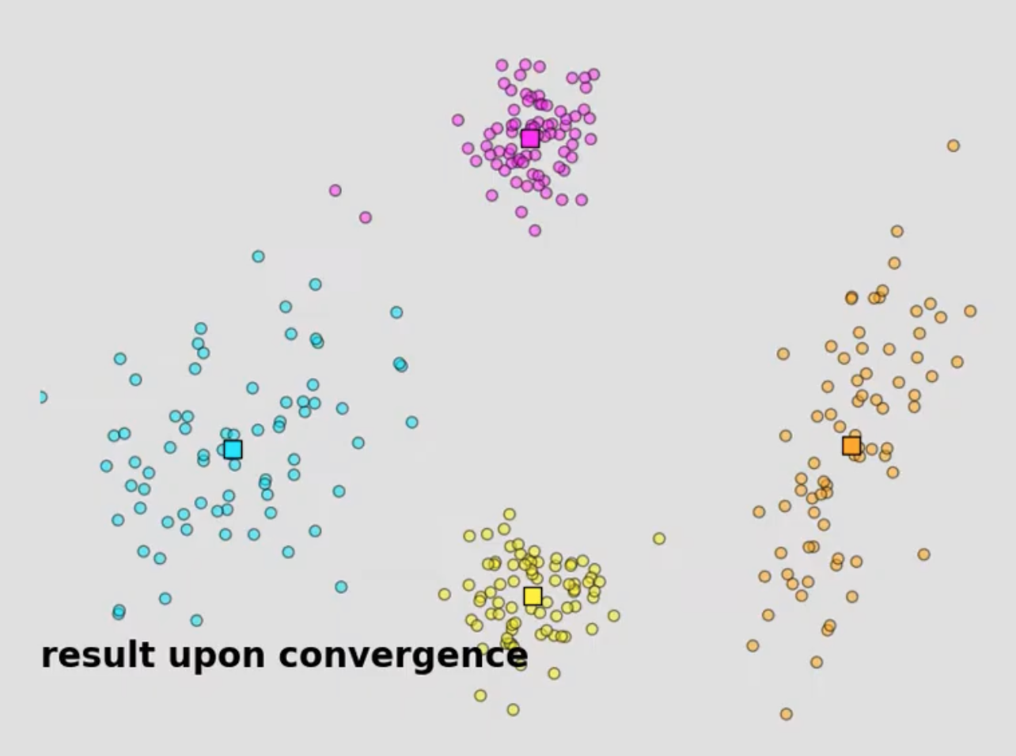
K-MEANS CLUSTERING ANIMATION
https://www.youtube.com/watch?v=5I3Ei69I40s&t=59s

Slide 19
K-MEANS DETAILS
For a very good detailed explanation of how K-Means works under the hood:
https://www.youtube.com/watch?v=lX-3nGHDhQg
Another very good video, if you can understand his accent, is: https://www.youtube.com/watch?v=iNlZ3IU5Ffw&t=300s
What are some of the advantages/disadvantages of the K-Means algorithm for clustering? When does it work well? When does it fail?
Notes:
Advantages of K-Means Clustering
Scalability & Efficiency – K-Means is computationally efficient, especially for large datasets, as it has a time complexity of O(nkd)O(nk d)O(nkd), where nnn is the number of data points, kkk is the number of clusters, and ddd is the dimensionality.
Simplicity – The algorithm is conceptually simple and easy to implement.
Guaranteed Convergence – Though it may converge to a local optimum, it always converges after a finite number of iterations.
Interpretability – Clusters are represented by their centroids, making it straightforward to analyze and interpret.
Works Well on Well-Separated Clusters – If the dataset consists of compact, spherical clusters of similar size, K-Means generally performs well.
Disadvantages of K-Means Clustering
Choice of K – The number of clusters kkk must be specified in advance, which can be difficult without prior knowledge.
Sensitivity to Initialization – Poor initialization can lead to suboptimal clustering; however, techniques like K-Means++ help mitigate this.
Sensitive to Outliers – Since K-Means minimizes squared distances, outliers can disproportionately affect the cluster centroids.
Assumption of Spherical Clusters – It assumes that clusters are convex and isotropic, which may not always be the case.
Hard Assignments – Each point is assigned to exactly one cluster, which can be limiting for overlapping clusters.
When Does K-Means Work Well?
When clusters are well-separated, compact, and roughly spherical.
When the dataset has low dimensionality.
When variance within clusters is low, meaning data points within each cluster are close to the centroid.
When Does K-Means Fail?
When clusters have non-spherical shapes (e.g., concentric rings or elongated clusters).
When clusters have varying sizes or densities.
When there are significant overlapping clusters.
When data contains a high level of noise or many outliers.
When feature scaling is inconsistent, since K-Means relies on Euclidean distance.

Slide 20
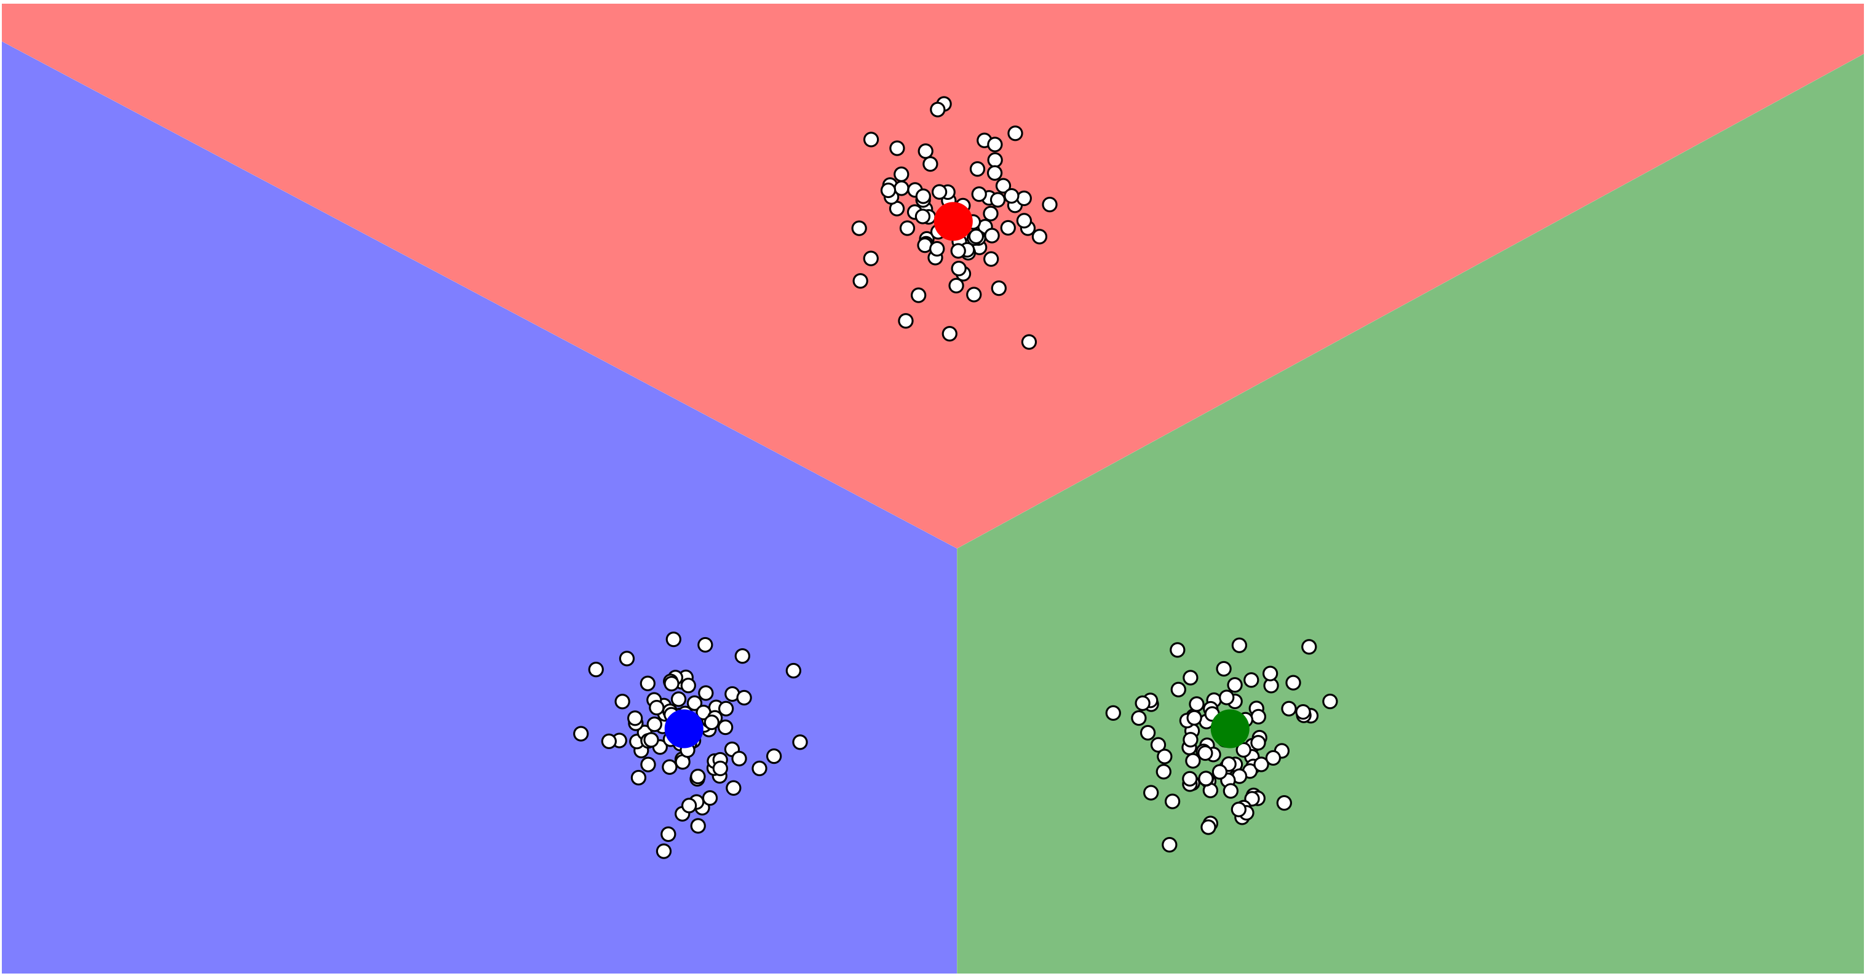
Visualizing K-Means
https://www.naftaliharris.com/blog/visualizing-k-means-clustering/

Slide 21
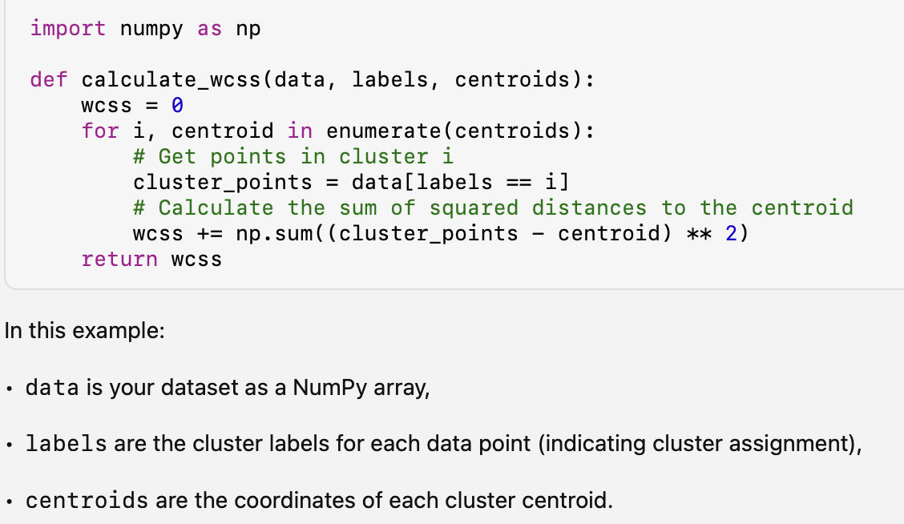
EVALUATION METHOD: WITHIN CLUSTER SUM OF SQUARES (WCSS)
The within-cluster sum of squares (WCSS) measures the compactness of a clustering result by calculating the sum of the squared distances between each data point and the centroid of the cluster it belongs to.
Here’s how to calculate the WCSS:
Identify the clusters: For each cluster, determine the data points assigned to it and calculate the centroid.
Calculate the squared distance: For each data point in a cluster, calculate the Euclidean distance to the cluster’s centroid. Then, square this distance.
Sum the squared distances: Sum up the squared distances for all points in the cluster to get the WCSS for that cluster.
Sum across all clusters: If you have multiple clusters, repeat the above steps for each cluster and sum the results to get the overall WCSS.

Slide 22
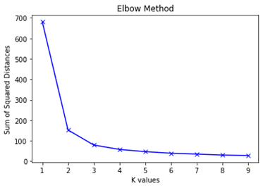
FINDING THE OPTIMAL K VALUE USING ELBOW METHOD
Steps:
1. For different values of K, execute the following steps:
2. For each cluster, calculate the sum of the squared distance of every point to its centroid.
3. Add the sum of squared distances of each cluster to get the total sum of squared distances for that value of K.
4. Keep adding the total sum of squared distances for each K to a list.
5. Plot the sum of squared distances (using the list created in the previous step) and their K values.
6. Select the K at which a sharp change occurs (looks like an elbow of the curve).
Notes:
The Elbow Method is a common technique used to determine the optimal number of clusters (k) for k-means clustering. The goal is to find the point where adding more clusters no longer significantly reduces the within-cluster sum of squares (WCSS), which measures the variance within each cluster. This “elbow” point typically represents the optimal k.
# Arbitrarily selecting a range of values for K K = range(1,10)
sum_of_squared_distances = []
# Using Scikit Learn’s KMeans Algorithm to find sum of squared distances
for k in K: model = KMeans(n_clusters=k).fit(X) sum_of_squared_distances.append(model.inertia_)
plt.plot(K, sum_of_squared_distances, “bx-”) plt.xlabel(“K values”) plt.ylabel(“Sum of Squared Distances”) plt.title(“Elbow Method”) plt.show()

Slide 23
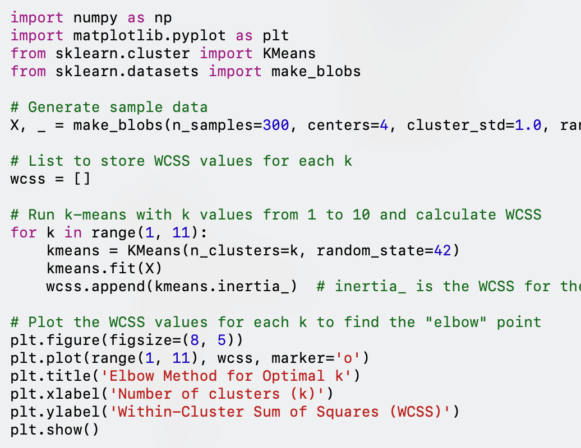
ELBOW PLOT CODE
1. Data Generation: Generate sample data with make_blobs for demonstration. In practice, you’d replace X with your dataset.
2. WCSS Calculation: Initialize an empty list wcss and use a loop to run KMeans with different values of k (from 1 to 10). The inertia_ attribute of the KMeans object gives the WCSS for the fitted clusters.
3. Plotting: The plot of WCSS vs. k shows how the WCSS decreases as we increase the number of clusters. The “elbow” in this plot indicates the optimal number of clusters, where increasing k further has diminishing returns on reducing WCSS.
4. Interpreting the Elbow Plot
The elbow point, where the WCSS curve starts to flatten, suggests the optimal number of clusters. Choosing a k beyond this point provides minimal additional clustering improvement.
Notes:
NOTE: UPDATE CODE AS A FUNCTION IN NOTEBOOK

Slide 24
SILHOUETTE METHOD FOR EVALUATION
The silhouette method is a technique for evaluating the quality of clustering, which can help determine the optimal number of clusters for a given dataset.
It quantifies how well each data point fits into its assigned cluster compared to other clusters.
Silhouette Coefficient: The silhouette coefficient is a measure of this fit, ranging from -1 to +1.
A higher score indicates better clustering.
The silhouette score combines the concepts of cohesion (how similar a point is to other points in its cluster) and separation (how dissimilar a point is to points in other clusters). [1]
Here's how the silhouette method works:
Calculate the silhouette coefficient for each data point. The silhouette coefficient for a data point i is calculated as:
(b(i) - a(i)) / max(a(i), b(i))
where:
a(i) is the average distance between point i and all other points in the same cluster.
b(i) is the average distance between point i and all points in the nearest neighboring cluster.
Calculate the average silhouette coefficient for all data points. This average score represents the overall quality of the clustering.
Repeat steps 1 and 2 for different numbers of clusters. By comparing the average silhouette coefficients for different k values, you can identify the number of clusters that produce the highest score, indicating the most optimal clustering structure.

Slide 25
SILHOUETTE METHOD EXAMPLE
Suppose you have a dataset and want to determine the optimal number of clusters using the silhouette method. You apply a clustering algorithm, such as K-Means, with different k values (e.g., k = 2, 3, 4, 5). For each k, you calculate the silhouette coefficient for each data point and then average those coefficients. Let's say you obtain the following average silhouette scores:
k = 2: 0.45
k = 3: 0.62
k = 4: 0.55
k = 5: 0.48
Observing the silhouette scores, the highest score occurs at k = 3. This suggests that 3 is the most suitable number of clusters for this dataset.
Advantages:
The silhouette method quantifies clustering quality, offering greater objectivity than visual methods like the elbow method.
It considers both cohesion and separation, giving a more comprehensive evaluation of cluster structure.
Limitations:
The calculation of silhouette coefficients can be computationally expensive, particularly for large datasets.
As with any clustering evaluation metric, the silhouette method is not a foolproof solution and should be used in conjunction with other methods and domain knowledge.

Slide 26
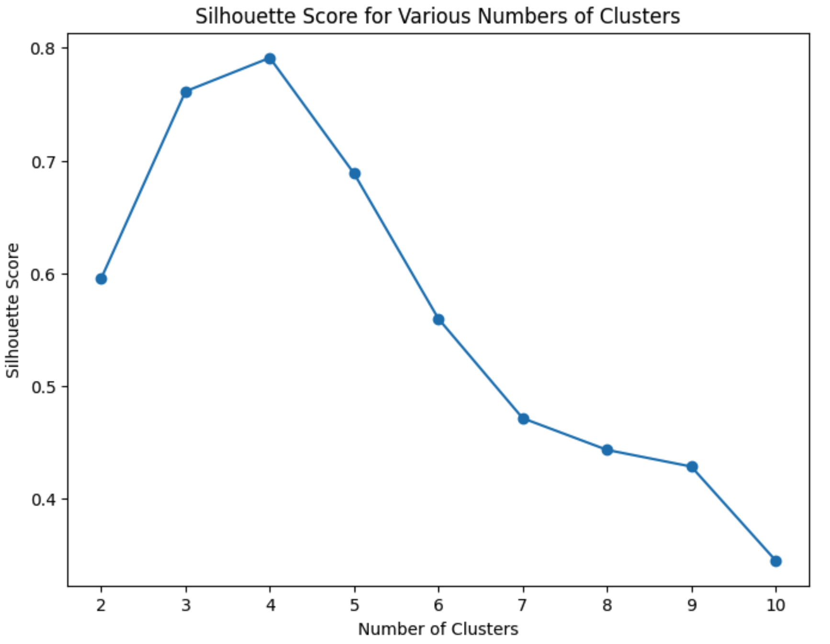
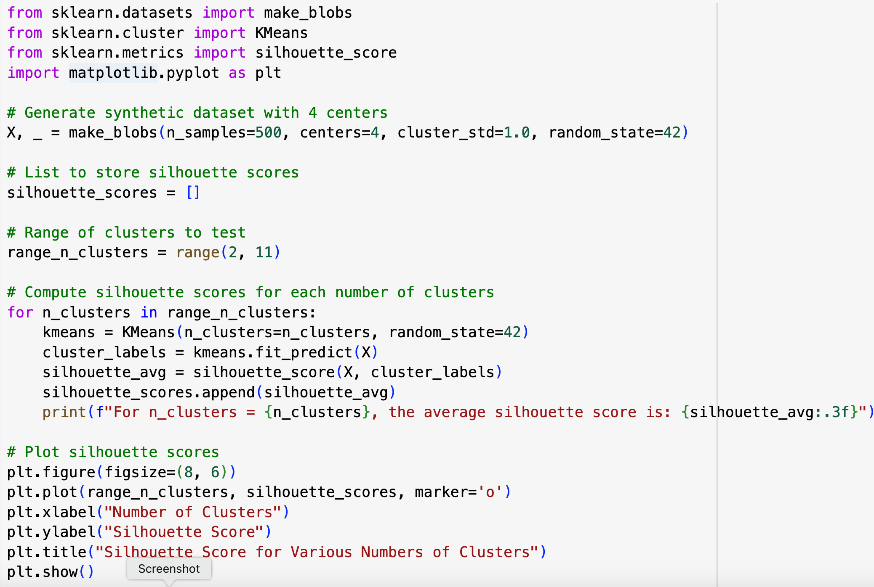
SILHOUETTE METHOD PYTHON CODE
Notes:
Explanation of the Code:
1. Data Generation: We generate a synthetic dataset with 4 centers.
2. Silhouette Calculation: For each K (from 2 to 10 clusters), we fit a KMeans model, predict the cluster labels, and calculate the silhouette score.
3. Plotting: We plot the silhouette scores to visually identify the optimal number of clusters.
The optimal K is the one with the highest silhouette score in the plot.

Slide 27
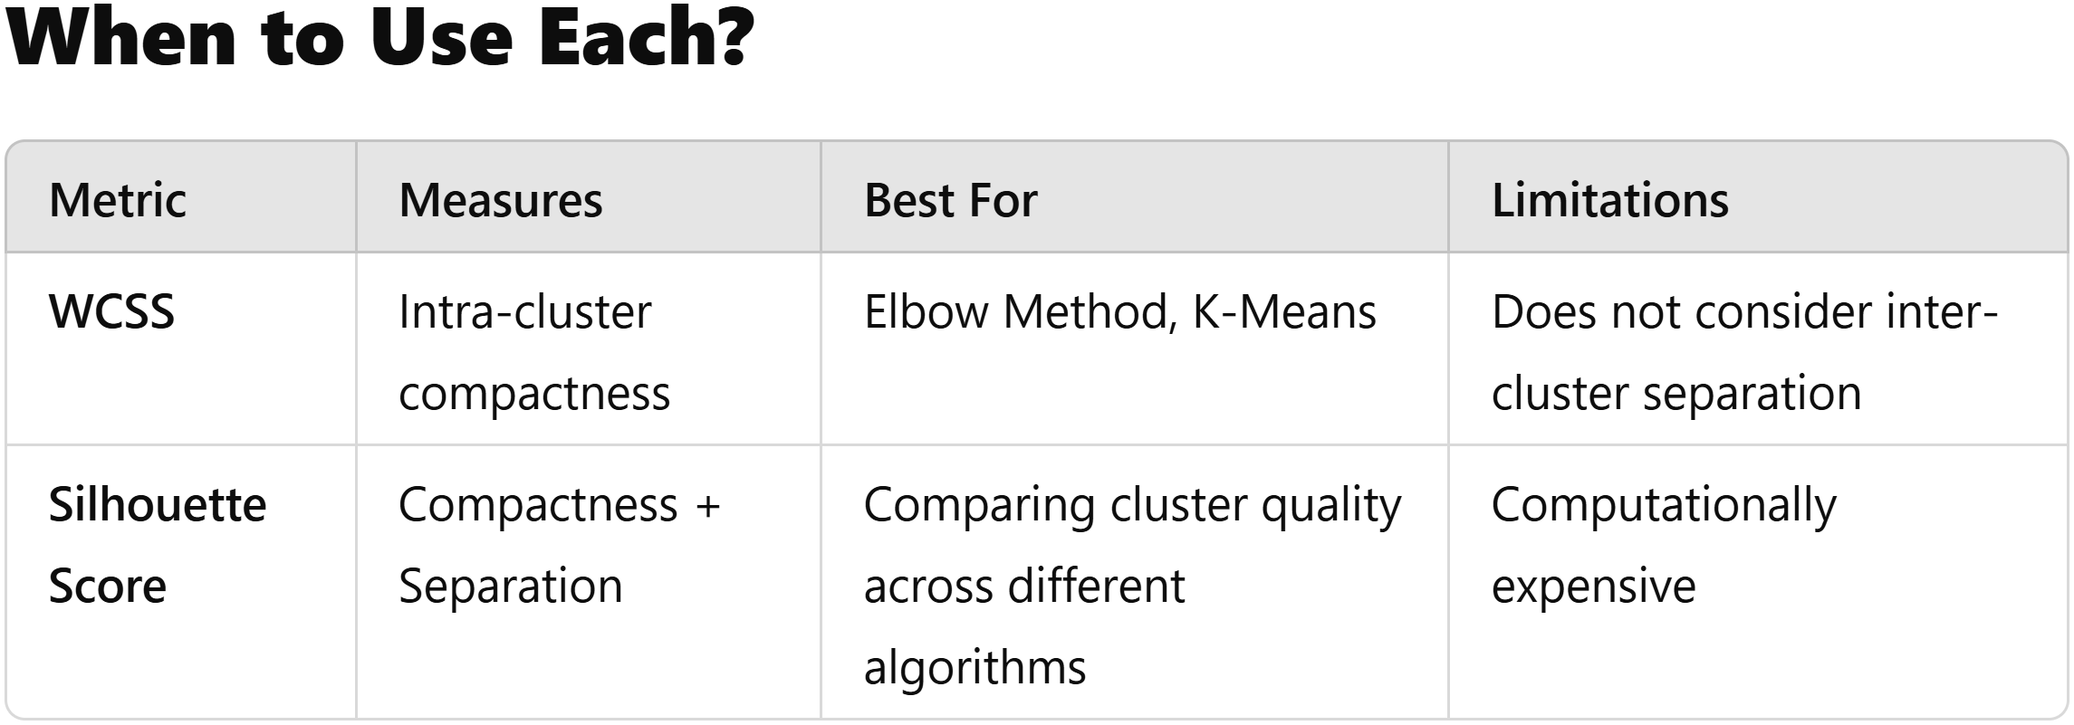
WSCC VS. SILHOUETTE

